Slide 1



MAJOR PROJECT [ETMJ100] on Unveiling Epilepsy: Machine Learning and Deep Learning Approaches for EEG Signal-Based Patient Detection
Presented by:
Mantra Jain (A2305220412)
Ansh Srivastav (A230522390)
Under Guidance of Dr. Harshit Bhardwaj
Affiliation: Department of Computer Science, Amity School of Engineering and Technology
Presentation Date: 29/05/2024
Amity University Noida, Sector – 125, Uttar Pradesh, India

Slide 2
Table of Contents
Problem Statement
Dataset and Setup
Machine Learning Model- Decision Tree
Bayesian Optimization
1D-CNN LSTM Architecture
Result Analysis
Conclusion
References
Introduction

Slide 3
Problem Statement
Epilepsy is a mental disorder characterized by sudden and unpredictable events that affects millions of people worldwide. These seizures are caused by electrical malfunctions in the brain and often present with symptoms that vary in intensity and duration.
It has an impact over 50 millions of worldwide population, positioning it as one of the most prevalent neurological conditions. Almost 80% of epileptics belongs to blue collar class, if given the right diagnosis and care in early stages, there are chances of making up to 70% of epileptics enjoy a seizure free life.
As per WHO in India, the average incidence of epilepsy is 5.59–10 per 1,000 individuals. In India, there are more than ten million epileptic sufferers, or more than 1% of the total population.
The incidence is higher in rural areas 1.9% in contrast to urban areas 0.6%.
The optimal treatment and management of epilepsy requires its diagnosis to be accurate and within the golden period i.e., before we can see the external symptoms of epilepsy like staring, jerking movements of the arms and legs or stiffening of the body.
Notes:
Individuals with epilepsy have a threefold increased risk of dying young compared to a healthy human being.
In developing or underdeveloped nations, 75% of epileptic patients do not undergo proper treatment and many may die undiagnosed. People suffering from epilepsy along with their families and relatives must face stigma and prejudice in many parts of the world.
February’s second Monday has been marked as International Epilepsy Day (IED), an internationally recognized healthcare event aimed at uniting epileptic patients and fostering a community where knowledge of the condition’s epidemiological profile, diagnosis, and treatment options is exchanged.
Epilepsy is a chronic brain disorder affecting nerves cell activity for an individual of all ages.

Slide 4
Introduction
Medical applications for machine learning have been growing rapidly, providing a wide range of opportunities for the analysis, diagnosis and classification of epilepsy.
These algorithms help us distinguish seizures from other conditions, predict the frequency of seizures, and use data from big, complex datasets from pattern recognition and data analytics to develop customized treatment plans for everyone.
We want to see the potential of machine learning and deep learning, including algorithms like logistic regression and CNN, in classification as we further explore the merger of technology and health.
With regards to machine learning, recurrent neural networks particularly those involving Long- Short Term Memory (LSTM) networks have shown potential in decoding complex patterns within time series data.
Normally RNN faces the gradient vanishing problem which is not an issue with LSTM, one of the RNN designs, which makes it easier to learn long-term relationships in time series data.
We are highlighting the need of using 1D-CNN LSTM ensembled (our suggested final model based on deep learning algorithms) networks in order to understand the temporal dynamics found in EEG data.
Notes:
With this integration comes a new way of enhancing diagnostic accuracy, predicting epilepsy occurrences as well as coming up with personalized and customized treatment plans.
We will examine the state-of-the-art models in epilepsy detection and classification in this report, focusing on the many types of system mastery algorithms employed as well as the statistical and computational techniques.

Slide 5
Dataset
I. BONN University-EEG Dataset
The dataset was developed at the University of Bonn in Germany towards enhancing computational analysis of epileptic seizure. This dataset consists of 100 single-channel EEG recordings, each lasting 23.6 seconds and sampled at a rate of 173.61 Hz.
Set | A | B | C | D | E
Subject | Vigorous | Vigorous | Epilepsy | Epilepsy | Epilepsy
Subject Condition during Readings | Not asleep with eyes opened | Not asleep with eyes closed | Seizure-free (interictal) |  | Seizure-free (ictal)
Electrode Type | Surface |  | Intracranial
Electrode Placement | International 10-20 System
Channels | 100
Duration | 23.6 Seconds
Notes:
The dataset contains 100 examples each of five classes of EEG data: eyesOpen, eyesClosed, epileptogenic, hippocampus, seizure.

Slide 6

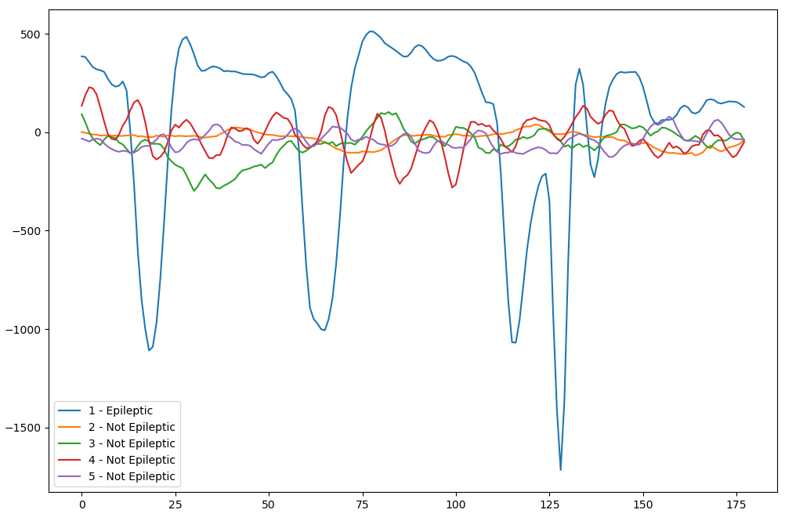

Subject Category | Subject State | Epileptic/Not Epileptic
1 | Epileptic Patient | Epileptic
2 | Brain With Tumour | Not Epileptic
3 | Healthy Brain | Not Epileptic
4 | Eyes Closed | Not Epileptic
5 | Eyes Open | Not Epileptic
II. UCI Machine Learning Dataset
Each of the five folders in the original dataset [10] has one hundred files, each of which represents a particular topic or individual. Every file contains a 23.6-second observation of neural activity. The 4097 data points were split up into 23 segments, with each segment holding 178 data points in a single second. Each segment had an EEG record value recorded at a distinct time period. Which gives 23 x 500 = 11500 data points in 1 second (column) for each item, and a label with y = 1, 2, 3, 4, and 5 in the last row.
Notes:
The original dataset is first pre-processed by the UCI and then published online. Each sample with 4097 data points is divided into 23 data chunks and each chunk has 178 data points of 1 s. After that, the 23 data chunks are shuffled. Finally, for the 500 subjects, 11,500 time-series EEG signal data samples are obtained.

Slide 7
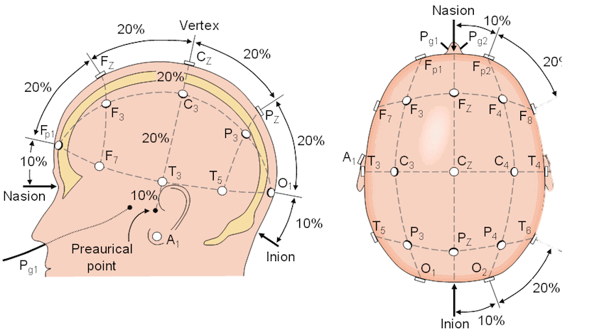
10-20 Electrode System
The 10-20 electrode system is a standardized method used for the placement of electrodes on the scalp for electroencephalography (EEG) recordings. The equipment which is used to measure the brain’s electrical activity is used in a non-invasive manner, it is used very commonly by the neurologist in their clinics to understand the functioning of the brain in real time.
10% and 20% respectively refers to the distance between the nasion, inion and distance along the sides of the skull (mastoid). The setting of the electrode placement is done in respect to these percentages, such as if the distance between the nasion, inion is of 10 equal segments. Then the electrodes are positioned at a specific percentage along the line.

Slide 8

Setup
The hardware used here is of an apple MacBook Air with M1 8 GB chipset having an integrated graphic card that consist of 8 cores, it is an integrated part of the recently developed chip named as M1 SoC by Apple. We have used Keras version 2.12.0 and Python version 3.7 for all the algorithms applied are hardware or version of the library used hasn’t changed.
A 90-10 train test split on the data is performed throughout the experiment. The number of training epochs for the CNN, 1D convolutional LSTM, and deep neural network (DNN) models is 100.
Notes:
Distribution of the data in a random manner is done before training, and then subsequently forwarded to the network. Furthermore, checkpoints are incorporated into the training process. During training, the model’s accuracy for each epoch’s training data set and test data set shall be calculated, that at the end of each epoch to allow us to assess whether that model is overfitted or in order to verify its generalization potential.

Slide 9

Machine Learning Model
Decision Tree
According to the distant qualities, we can create a tree like structure which can further be used to identify whether the patient is epileptic or non-epileptic based on the distinct characteristics shown by the data in the training phase, this approach makes the use of internal structure tree as a tool for the decision making.
To get homogeneous subsets, it is necessary to decrease the disorder and impurity in the data, which may be done with the criterion measure. Until every sample in a node has the same class label, the recursive process goes on for every subset. It then finally stops until a stopping condition such as the maximum depth or the minimum number of samples per leaf is met.
Notes:
Decision tree was the best performing model among the applied various learning models such as KNN, SVM, Random Forest and logistic regression. Therefore, we are explaining that only.
A tree like structure is produced by recursively splitting the data based on unique attributes, and this structure is utilized to determine the class labels of individual instances. This method functions by exploiting the internal structure as a decision-making tool.

Slide 10

Bayesian Optimization
We have used Bayesian Optimization for Hyperparameter Optimization.
Step 1: Choose Random Points and use them to create a surrogate function.
Step 2: Iterate by adding more points using Acquisition Function, Re-evaluate Surrogate Fn.
Continue loop unless following occurs:
surrogate function max does not change
or variance below threshold
Or fn is exhausted. (if we don't want to extend the application )
Hyper parameter optimization aims to maximise the accuracy of the model while preventing the overfitting. Thus, it finds a balance between the models complexity and generalized performance.
Notes:
Examples of hyperparameters include the number of nodes and layers in a neural network and the number of branches in a decision tree. Hyperparameters determine key features such as model architecture, learning rate, and model complexity.
Hyperparameters directly control model structure, function, and performance. Hyperparameter tuning allows data scientists to tweak model performance for optimal results. This process is an essential part of machine learning, and choosing appropriate hyperparameter values is crucial for success.
A surrogate is a function that approximates another function.
Surrogate models in Bayesian optimization serve as a proxy for the true objective function.
Acquisition functions are mathematical techniques that guide how the parameter space should be explored during Bayesian optimization.

Slide 11
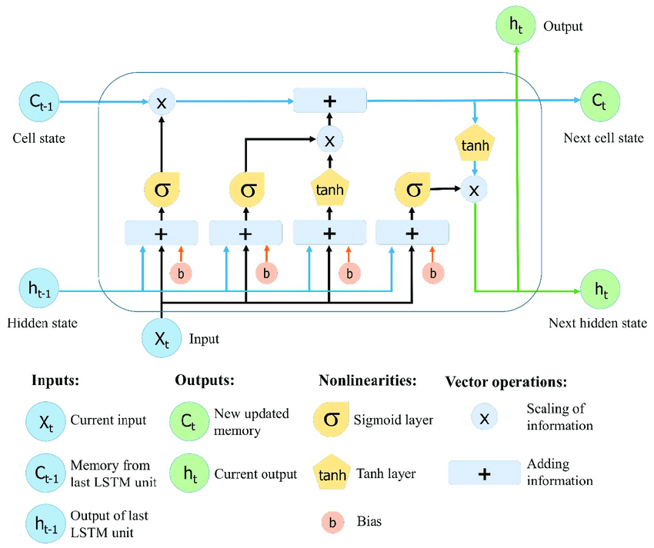
1D CNN LSTM
1D CNN
To obtain representations and effective features from 1D time series convolution sequence data, a 1D-CNN may perform 1D operations with different filters. To confirm to the single dimensional nature of the raw EEG signal data, the feature maps and convolutional filters of the 1D CNNs used in this work are entirely one dimensional. By increasing the number of convolutional layers, CNN is capable of progressively generating higher level features for epileptic seizure detection tasks which are resistant and discriminable.
LSTM
The first stage in a Long Short-Term Memory unit determines what percentage of the Long-Term Memory is remembered.
Side Figure represents the LSTM block consisting four gates.
Notes:
Basic, Recurrent Neural Networks are hard to train because the gradients can explode or vanish.
LSTM uses Sigmoid and TanH activation functions
In a nutshell, the Sigmoid Activation Function takes any x-axis coordinate and turns it into a y-axis coordinate between 0 and 1.
In contrast the tanh, or Hyperbolic Tangent, Activation Function takes any x-axis coordinate and turns it into a y-axis coordinate between -1 and 1.
LSTMs introduce a unique structure consisting of cells, each with three main components: gates, states, and an output. These components allow LSTMs to maintain and update long-term dependencies in the data.
Even though first part of the Long Short-Term Memory unit determines what percentage of the Long-Term Memory will be remembered it is usually called the Forget Gate.
Benefits of LSTM
Avoids Vanishing/Exploding Gradients: LSTMs mitigate the vanishing gradient problem through their gate mechanism, which allows them to retain and propagate important gradients through longer sequences.
Captures Long-Term Dependencies: LSTMs are designed to remember information for long periods, making them suitable for tasks where context over long sequences is essential.
Flexible and Powerful: They are versatile and can be applied to various sequence prediction problems, from language modeling to time series forecasting.
In machine learning, the vanishing gradient problem is encountered when training neural networks with gradient-based learning methods and backpropagation. In such methods, during each iteration of training each of the neural networks weights receives an update proportional to the partial derivative of the error function with respect to the current weight.^{[1]} The problem is that as the sequence length increases, the gradient magnitude typically is expected to decrease (or grow uncontrollably), slowing the training process.^{[1]} In the worst case, this may completely stop the neural network from further training.

Slide 12
Pooling and FC Layer
Pooling Layer
Pooling layers to reduce the size of the representation, to speed the computation, as well as make some of the features that it detects a bit more robust.
FC Layer
The weights and biases in FC layers are learned during the training process, making them adapt to the specific problem at hand.
After classifying we use FC layer to connect extracted features to two categories namely Epileptic and non-epileptic.
To do this we flatten the signal into a 1D vector.
Every single neuron of the current layer is connected to both the previous and the next layer.
Notes:
Pooling Layers, also known as downsample layers, are an essential component of convolutional neural networks (CNNs) used in deep learning. They are responsible for reducing the spatial dimensions of the input data, in terms of width and height, while retaining the most important information.
The fully connected layers are able to very effectively learn non-linear combinations of input features.
The output from the convolutional layers represents high-level features in the data. While that output could be flattened and connected to the output layer, adding a fully-connected layer is a way of learning non-linear combinations of these features.
Essentially the convolutional layers are providing a meaningful, low-dimensional, and somewhat invariant feature space, and the fully-connected layer is learning a (possibly non-linear) function in that space.

Slide 13
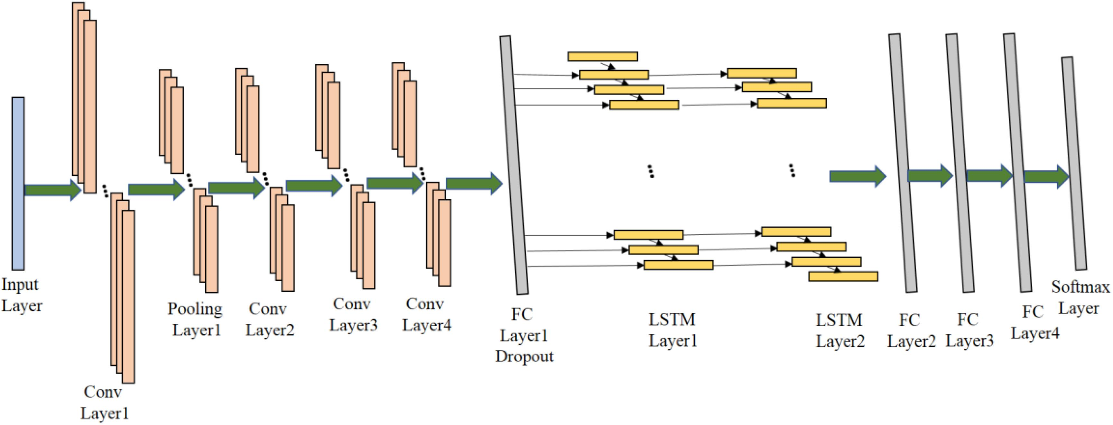
4 Convolutional layers, 2 LSTM layers, 1 input layer, 1 pooling layer, 4 fully connected (FC) layers, and a SoftMax output layer make up the suggested ensemble model. First, as the data source for the proposed model, the 45 X 1 form of the one-dimensional EEG signal data is used after that, to extract abstraction features from the raw signal data, input data is transmitted through an initial convolution layer composed of 64 one dimensional convolution kernels with a shape of 3 X 1 and a length of 1, respectively.
Notes:
First, as the data source for the proposed model, the 45 X 1 form of the one- dimensional EEG signal data is used after that, to extract abstraction features from the raw signal data
Both the size and the stride of the pooling windows in the Pooling Layer one are 2. It can speed up the training process and drastically lower the overall training parameters in the suggested model.
Subsequently, 3 convolutional layers are employed to additionally extract advanced characteristics that may aid in categorization.
By deepening the number of convolutional layers, the CNN can gradually extract higher-level features which are robust and discriminative for the epileptic seizure recognition tasks.
After passing through each of the one-dimensional convolution layers, the resulting 1024 feature maps, each measuring 43 X 64, will be fed into a single 256 neuron FC layer,
In order to prevent the prolonged dependence of the conventional RNN, the output features are sent to the LSTM layers after going across the FC layer1.
In neural networks, a Fully Connected (FC) layer, also known as a dense layer, is a layer where each neuron is connected to every neuron in the previous layer. This dense connectivity is computationally powerful but can lead to overfitting, where the model performs well on training data but poorly on unseen data. To mitigate this, various regularization techniques are used, one of which is dropout.
Each FC layer transforms the features from the previous layer into a new space, which can make it easier to classify or predict the final output. These transformations can help in separating classes that are not linearly separable in the original feature space.
Lastly, a layer of SoftMax output is applied in the ensemble model for better results. Softmax is an activation function that scales numbers into probabilities. The output of a Softmax is a vector with probabilities of each possible outcome.
In line with the specific results produced by Bayesian hyperparameter optimization, the proposed model’s more detailed structure has been modified.

Slide 14
Result Analysis
A 90-10 train test split on the data is performed throughout the experiment. With a 99.47% accuracy rate, the suggested model outperforms KNN by 7.7%, SVM by 5%, and DT by 2.27% as compared to the machine learning algorithms applied in paper [19]. This drives to the fact that suggested 1D-CNN LSTM ensemble model has great potential in the field of epileptic seizure detection research through EEG signals, as demonstrated by all these results
Model | Accuracy | Precesion | Recall | F1-Score
CNN | 97.13% | 94.24% | 92.34% | 0.9328
DNN | 96.35% | 95.18% | 87.50% | 0.9118
Suggested 1D-CNN LSTM | 99.47% | 99% | 99% | 0.9959

Slide 15
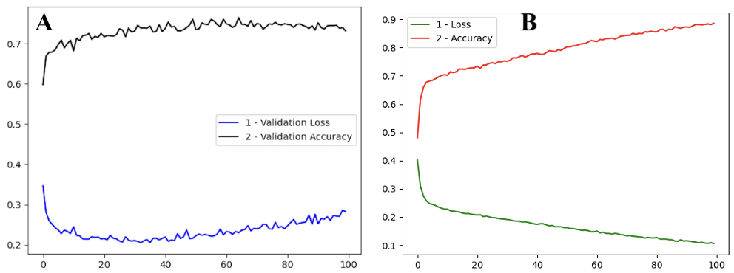
Training and Validation Accuracies (A) Validation Loss and Accuracy (B) Training Loss and Accuracy
Notes:
Y- Axis: Accuracy
X- Axis: Epochs
he accuracy curve (also known as the training accuracy curve) shows us how good the model is at making correct predictions on the training data as it goes through the training process. Accuracy is measured in percentages and tells us the proportion of instances the model correctly classified out of the total number of instances.

Slide 16
Conclusion
This report has conducted a comprehensive examination of machine learning methodologies for seizure detection. Consequently, it is concluded that “non-black-box” classifiers, specifically the decision forest among the basic Machine Learning, exhibit superior effectiveness. This choice is motivated by their ability to generate several logical and informative rules while maintaining a higher prediction accuracy.
However, a bit more complex 1D-CNN LSTM ensemble epilepsy seizure detection model is proposed in this study using EEG signal as input. The proposed ensemble model will build an entire network i.e. by combining a LSTM with 1D-CNN, it will be able to distinguish precisely between the ordinary and epileptic seizures EEG data. The LSTM model is successful in identifying and interpreting the individual EEG signals, whereas the 1D-CNN picks out features from EEG data very well.
Model | Accuracy | Precesion
1D-CNN LSTM | 99.47% | 99%
Decision Tree* | 97.2% | 96%
Difference | 2.05% | 3%
* Decision Tree Using 70-30 Split

Slide 17
References
[1] Abeg Kumar Jaiswal and Haider Banka. Epileptic seizure detection in eeg signal using machine learning techniques. Australasian physical & engineering sciences in medicine, 41:81–94, 2018.
[2] WHO, “World health organization 2024.” https://www.who.int/ news-room/fact-sheets/detail/epilepsy. Accessed: Feb 12, 2024.
[3] T. T. Joy, S. Rana, S. Gupta, and S. Venkatesh, “Fast hyperparameter tuning using bayesian optimization with directional derivatives,”Knowledge-Based Systems, vol. 205, p. 106247, 2020.
[4] TMSi. “The 10-20 System for EEG.” TMSi, 21 Feb. 2023, info.tmsi.com/blog/the-10-20-system-for-eeg. Accessed 01 Feb. 2024.
[5] Supriya, S., Siuly, S., Wang, H. et al. Automated epilepsy detection techniques from electroencephalogram signals: a review study.Health Inf Sci Syst 8, 33 (2020).
[6] Q. Wu and E. Fokoue, “Epileptic Seizure Recognition.” UCI Machine Learning Repository, 2017. DOI: https://doi.org/10.24432/C5G308.
[7] Zarei R, He J, Siuly S, Huang G, Zhang Y. Exploring Douglas-Peucker algorithm in the detection of epileptic seizure from multicategory EEG signals. Biomed Res Int. 2019; 2019:1–19.

Slide 18

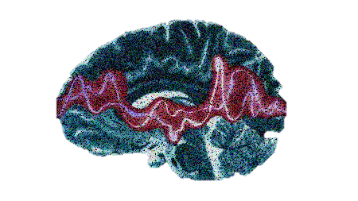
Thank You
Regards:
B.TECH- CSE 8Y (2020-24)
Mantra Jain (A2305220412)
Ansh Srivastav (A2305220390)

